Slide 1
Ontology Web Language

Slide 2


Summarizing the Problem: Computers don’t understand Meaning
“My mouse is broken. I need a new one…”

Slide 3


The Semantic Web Vision
“… the idea of having data on the Web defined and linked in a way that it can be used by machines not just for display purposes ,but for automation, integration and reuse of data across various applications”
http://www.w3.org/sw/
Notes:
הרעיון של הווב הסמנטי הוא שהנתונים בווב יוגדרו ויקושרו בצורה כזו שמחשבים יוכלו להשתמש בהם לא רק לצורכי הצגה אלא גם לאוטומציה אינטגרציה ושימוש חוזר בנתונים ע"י סוגים שונים של אפליקציות

Slide 4
The Semantic Web
"The Semantic Web is an extension of the current web in which information is given well-defined meaning, better enabling computers and people to work in cooperation."
applications
agents
Notes:
הווב הסמנטי הוא הרחבה של הווב הנוכחי שיאפשר למחשבים ואנשים לעבוד בשיתוף פעולה

Slide 5



Need to Add “Semantics”
Use Ontologies to specify meaning of annotations
Ontologies provide a vocabulary of terms
New terms can be formed by combining existing ones
Meaning (semantics) of such terms is formally specified
Can also specify relationships between terms in multiple ontologies

Slide 6
Ontology: Origins and History Ontology in Philosophy
A philosophical discipline - a branch of philosophy that deals with the nature and the organisation of reality
Science of Being (Aristotle, Metaphysics, IV, 1)
Tries to answer the questions:
What characterizes being?
Eventually, what is being?

Slide 7
Ontology in Computer Science
An ontology is an engineering artifact:
It is constituted by a specific vocabulary used to describe a certain reality, plus
a set of explicit assumptions regarding the intended meaning of the vocabulary.
Thus, an ontology describes a formal specification of a certain domain:
Shared understanding of a domain of interest
Formal and machine manipulable model of a domain of interest
Notes:
אונתולגיה נוצרת על יד בני אדם באופן הנדסי.
מורכב מאוצר מילים ספציפי שנועד לתאר מציאות מסוימת
קבוצה של הנחות מפורשות הנוגעות למשמעות של אוצר המילים.
כלומר אונתולוגיה מתארת דומיין בצורה פורמאלית
הבנה משותפת של תחום עניין
פורמלי וניתן למניפולציה על ידי מכונה

Slide 8


Structure of an Ontology
Ontologies typically have two distinct components:
Names for important concepts in the domain
Elephant is a concept whose members are a kind of animal
Herbivore is a concept whose members are exactly those animals who eat only plants or parts of plants
Adult_Elephant is a concept whose members are exactly those elephants whose age is greater than 20 years
Background knowledge/constraints on the domain
Adult_Elephants weigh at least 2,000 kg
All Elephants are either African_Elephants or Indian_Elephants
No individual can be both a Herbivore and a Carnivore
Notes:
מבנה של אונתולגיה
לאונתולגיות יש שני מרכיבים ברורים:
שמות למושגים בתחום:
פיל, אוכל עשב, פיל בוגר
ידע מוקדם או אילוצים על התחום
פיל בוגר שוקל לפחות 2000
כל הפילים הם או פילים אפריקאיים או הודים
אין פרט שיכול להיות גם אוכל עשב וגם טורף.

Slide 9
Ontology Example
Concept
conceptual entity of the domain
Attribute
property of a concept
Relation
relationship between concepts or properties
Axiom
coherent description between Concepts / Properties / Relations via logical expressions
name
email
Person
student nr.
research
field
isA – hierarchy (taxonomy)
Student
Professor
attends
holds
Lecture
lecture
nr.
topic
holds(Professor, Lecture) ⇒ Lecture.topic ∈ Professor.researchField

Slide 10
Ontology Elements
Concepts (classes) + their hierarchy
Concept properties (slots/attributes)
Property restrictions (type, cardinality, domain)
Relations between concepts (disjoint, equality)
Instances

Slide 11
How to build an ontology?
Steps:
determine domain and scope
enumerate important terms
define classes and class hierarchies
define slots
define slot restrictions (cardinality, value-type

Slide 12
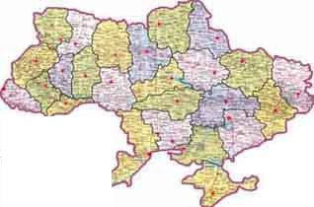
Step 1: Determine Domain and Scope
Domain: geography
Application: route planning agent
Possible questions:
Distance between two cities?
What sort of connections exist between two cities?
In which country is a city?
How many borders are crossed?

Slide 13

Step 2: Enumerate Important Terms
city
capital
Connection_on_land
country
border
road
railway
Connection_on_water
currency
Connection_in_air
connection

Slide 14
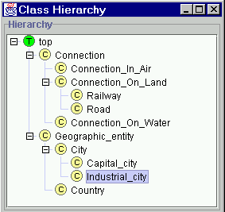
Step 3: Define Classes and Class Hierarchy

Slide 15
Step 4: Define Slots of Classes
Geographic_entity
End_point
Connection
Country
City
Start_point
Has_capital
Borders_with
Capital_of
Capital_city

Slide 16
Step 5: Define slot constraints
Slot-cardinality
Ex: Borders_with multiple, Start_point single
Slot-value type
Ex: Borders_with- Country

Slide 17
OWL Constructs Included
owl:InverseFunctionalProperty
owl:sameAs
owl:FunctionalProperty
owl:InverseFunctionalProperty
owl:SymmetricProperty
owl:TransitiveProperty
owl:sameAs
owl:inverseOf
owl:equivalentClass
owl:equivalentProperty
owl:hasValue
owl:someValuesFrom
owl:allValuesFrom

Slide 18

OWL Example
There are two types of animals, Male and Female.
<rdfs:Class rdf:ID="Male">
<rdfs:subClassOf rdf:resource="#Animal"/>
</rdfs:Class>
The subClassOf element asserts that its subject - Male - is a subclass of its object -- the resource identified by #Animal.
<rdfs:Class rdf:ID="Female">
<rdfs:subClassOf rdf:resource="#Animal"/>
<owl:disjointWith rdf:resource="#Male"/>
</rdfs:Class>
Some animals are Female, too, but nothing can be both Male and Female (in this ontology) because these two classes are disjoint (using the disjointWith tag).

Slide 19
OWL Example in Protégé (1)
Class
Person superclass
Man, Woman subclasses
Properties
isWifeOf, isHusbandOf
Property characteristics, restrictions
inverseOf
domain
range
Cardinality
Class expressions
disjointWith

Slide 20
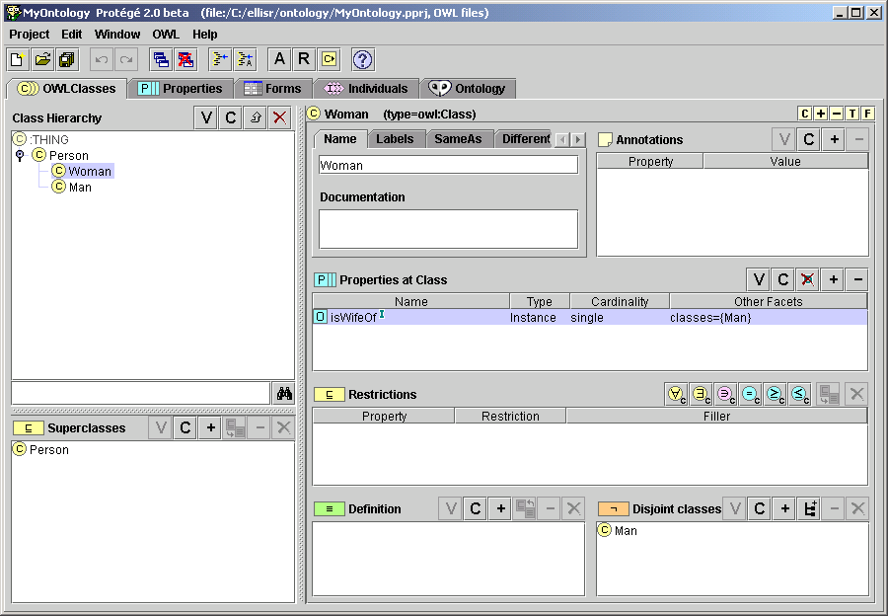
OWL Example in Protégé (2)

Slide 21
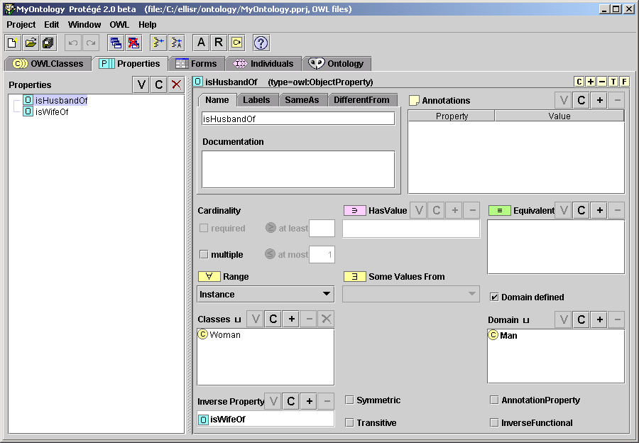
OWL Example in Protégé (3)

Slide 22
Ontology-development tools
Ontology-development tools
Protégé
OntoEdit
OilEd
Chimaera
…

